Slide 1
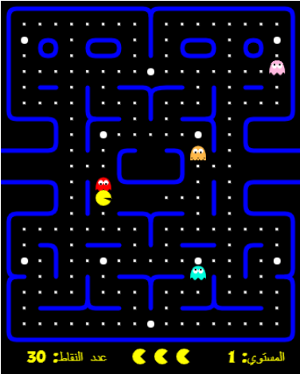

Pac
Pac - Man

Slide 2
Pac-Man Game
Methodology:
Pac-Man Game
There is a maze with ghosts inside, and there is a Pac-Man inside this maze who wants to eat all the cheese without these ghosts killing him so that he can win this maze.
Submitted by:
Student Name
Student Email
Section
Waleed Hesham Anter
Nour Eldeen Ahmed Shabana
Nour Eldeen Emad
waleedanter@std.mans.edu.eg
nourahmei@std.mans.edu.eg
nourelfera@std.mans.edu.eg
15
15
15
Our Supervisors
Dr. Sara El-Metwally Eng. Amany Sherif

Slide 3
Used Technology:
Html – JavaScript Web App
Pac-Man Game
Agent Design (PEAS): Pac-Man
- Performance measure: Score, lives
- Environment: Maze containing white dots, four ghosts, power pills, occasionally appearing fruit
- Actuators: Game screen
- Sensors: Arrow keys
Agent program
goal-based reflex agent
Environment Properties (ODESDA) Pac-Man
Task Environment | Observable | Agents | Deterministic | Episodic | Static | Discrete
Pac-Man | Fully | Single | Deterministic | Episodic | Static | Discrete
AI Algorithm
Breadth First Search) BFS)

Slide 4
Problem formulation
The Pacman is in a place on the map, ghosts are in the center of the map, and a lot of cheese is spread across the map.
Initial state
The Pacman can move up, down, right or left, yet ghosts move in random directions.
Successor function
It is the case in which all the cheese spread on the map has been eaten by the Pacman.
Goal test
Considering that each step of the Pac-man, whether it is up, down, left or right, increases the cost by one.
Path cost
Pac-Man Game

Slide 5

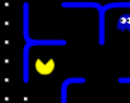
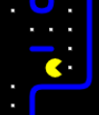
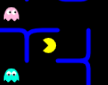
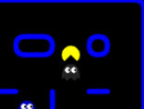
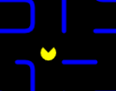
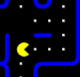
Pac-Man Game
Game tree
(right1,1)
(up 1,1)
(left 2,2)
(up 2,2)
(down3,3)
(up 3,3)
(right 1,1)

Slide 6
Pac
Thank You

